Slide 1
COMMON VOCABULARY IN FINANCIAL LITERACY

Slide 2

BASIC FINANCIAL CONCEPTS
Savings Account:
A bank account that earns interest on the money deposited.
Checking Account:
A bank account for daily transactions, often with no interest.
Balance:
The amount of money available in an account.
Emergency Fund:
Savings set aside for unexpected expenses.

Slide 3

Budget:
A plan for managing income and expenses.
Savings:
Money set aside for future use.
Debt:
Money borrowed that needs to be repaid.
Interest:
The cost of borrowing money or the earnings on savings.

Slide 4

INVESTMENT
Stocks:
Shares of ownership in a company.
Bonds:
Loans made to corporations or governments that pay interest over time.
Diversification:
Spreading investments across different assets to reduce risk.
Portfolio:
A collection of investments owned by an individual or institution.

Slide 5

BANKING
Checking Account:
A bank account for everyday transactions.
Savings Account:
An account that earns interest on deposits.
Overdraft:
Spending more than what's available in an account, leading to fees.
ATM (Automated Teller Machine):
A machine for withdrawing money or performing basic banking tasks.

Slide 6
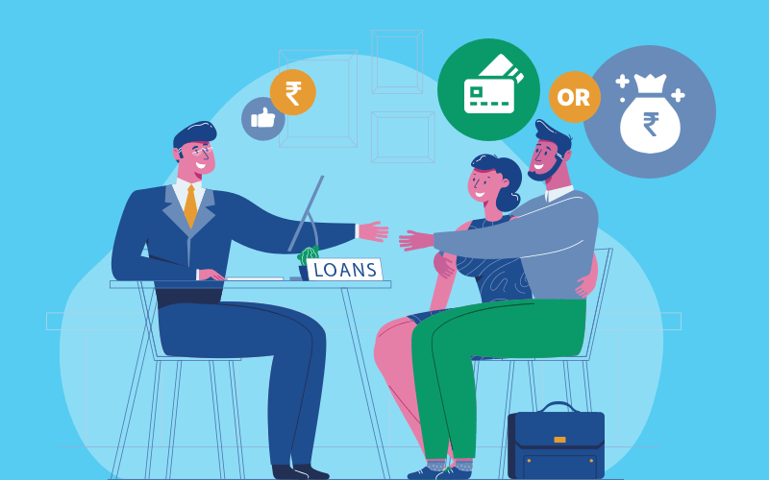
CREDIT AND LOANS
Credit Score:
A numerical representation of a person's creditworthiness.
Loan:
Money borrowed that must be repaid with interest.
Mortgage:
A loan used to buy real estate, typically paid back over many years.
Interest Rate:
The percentage charged on borrowed money or earned on deposits.

Slide 7
ECONOMIC TERMS
Inflation:
The rate at which the general level of prices rises over time.
Recession:
A period of economic decline, typically marked by falling GDP and rising unemployment.
GDP (Gross Domestic Product):
The total value of goods and services produced in a country in a year.

